Slide 1

DETECTION AND CLASSIFICATION OF FRUIT DISEASES
Date: 09 April 2021
MEDARAMATLA GAYATRI : 17WH1A0540
USAKOILA MOUNIKA :17WH1A0550
SAMA NISCHALA : 18WH5A0506
Internal Guide: Ms. A.Kranthi
Designation: Assistant Professor
Department of Computer Science & Engineering
BVRIT HYDERABAD College of Engineering for Women

Slide 2
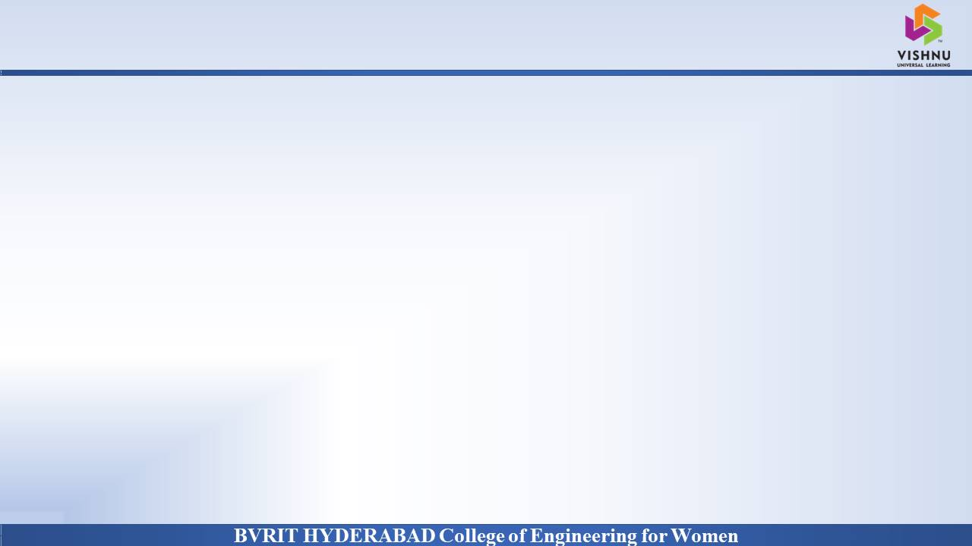
Project Introduction
Why Should I Study this course?
DOMAIN
Image Processing With ML
PROJECT TYPE
Proposed system
The classification and segmentation of fruit images were performed using K-Means Algorithm and SVM technique. The various features of few fruits were initially extracted and segment the respective images. After comparison with feature values, the various disease names are analyzed and the optimal disease for the image is identified and the disease is indicated by an alert box and can be provided as the message through mobile application
Examples
BVRIT HYDERABAD College of Engineering for Women

Slide 3
System specifications
Why Should I Study this course?
Examples
ENVIRONMENT | SPECIFICATIONS
HARDWARE | Processor - Intel Core i5 Memory(RAM) - 8 GB Storage – 250 GB
SOFTWARE | Python idel 3.7 version (or) Anaconda 3.7 OS – Windows
BVRIT HYDERABAD College of Engineering for Women

Slide 4
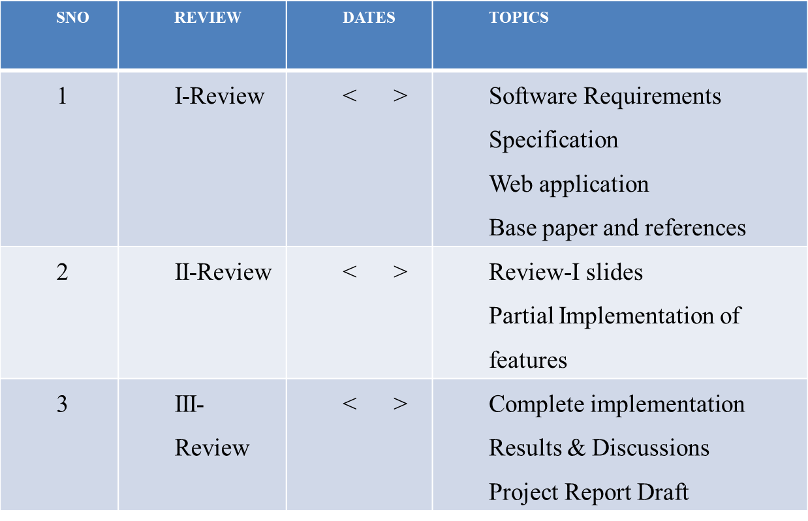
Project plan
Why Should I Study this course?
Examples
BVRIT HYDERABAD College of Engineering for Women

Slide 5
References
Why Should I Study this course?
Examples
[1] Base paper:
https://ieeexplore.ieee.org/abstract/document/9104139
[2] Reference papers:
https://www.irjet.net/archives/V4/i12/IRJET-V4I12213.pdf
https://md-datasets-cache-zipfiles-prod.s3.eu-west-1.amazonaws.com/3f83gxmv57-2.zip
BVRIT HYDERABAD College of Engineering for Women

Slide 6
Thank you
BVRIT HYDERABAD College of Engineering for Women

